Slide 1


Password generator
Presented by:
Name: Vedant Hingu
Enrollment no: 23002171310178
Roll no:252
Branch: CST
Batch :B9

Slide 2
Introduction
Good morning respected ma'am/sir, this is a password generator project where u just have to tell me the type of password u want and we will create that kind of password for you . You will be given options for choosing the type of password you want .You can create as many passwords as you want from this project .
The main aim of this project is to help people generate numerous passwords easily.

Slide 3
TYPES OF PASSWORD
You can generate any type of password given below using this project :
Password which includes random characters of your given length. It may include capital or small letters, signs or symbols or numbers.
Password which includes your name and your birth year
Password which includes random 4 digits
Password which includes random 6 digits
Password which includes your surname and birthdate

Slide 4
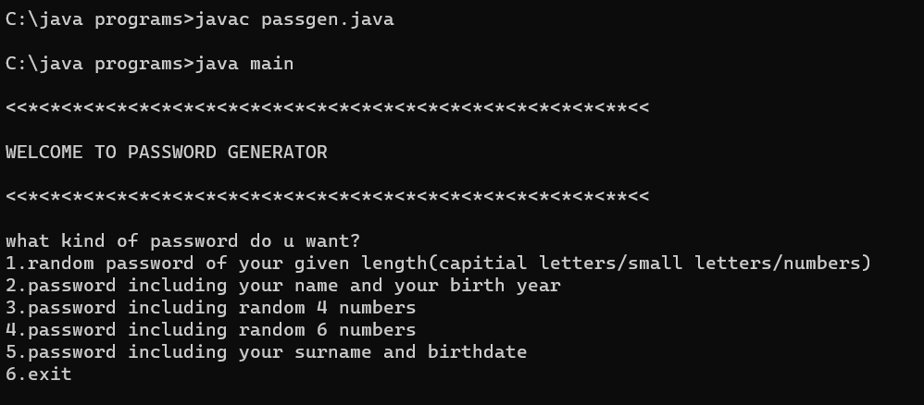
Basic user interface

Slide 5
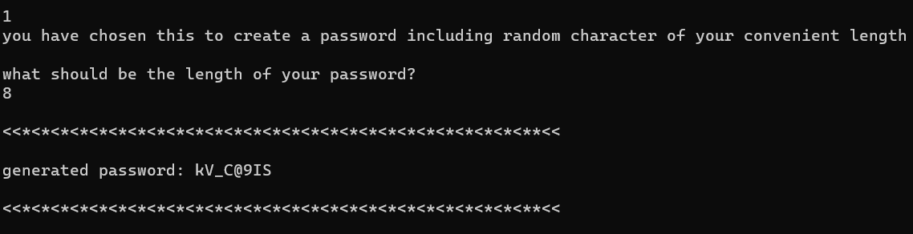
1. Random character password

Slide 6
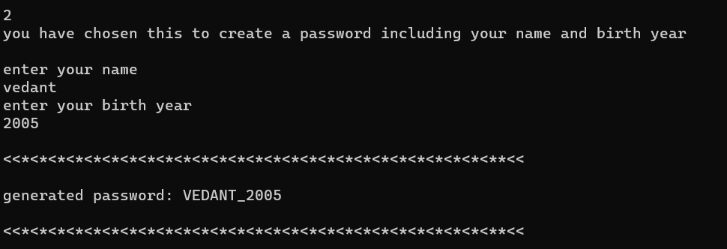
2. Name and birth year password

Slide 7
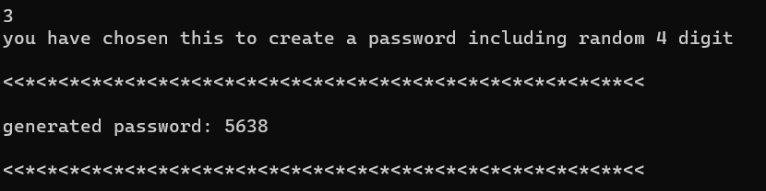
3. Random 4 digit password

Slide 8
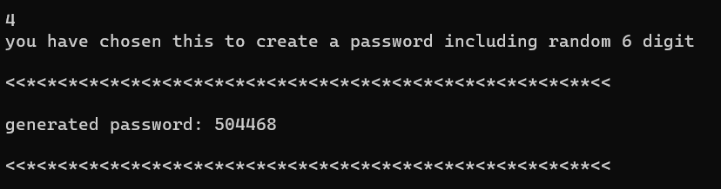
4. Random 6 digit password

Slide 9
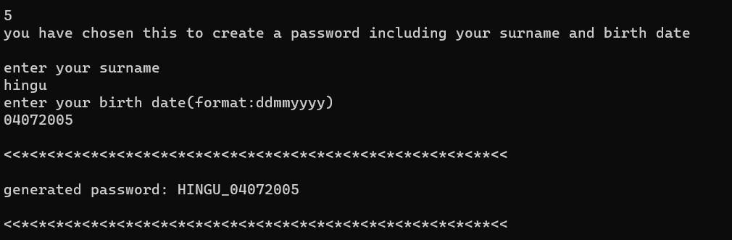
5. Surname and birthdate password

Slide 10
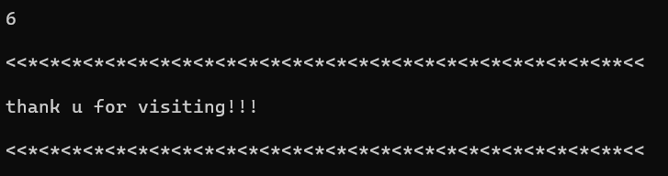
Exit interface

Slide 11
Thank you

